Slide 1

Overview of github pages
Workshop Development Platform

Slide 2
Benefit Github Pages
Free
Easy to use
Fast

Slide 3
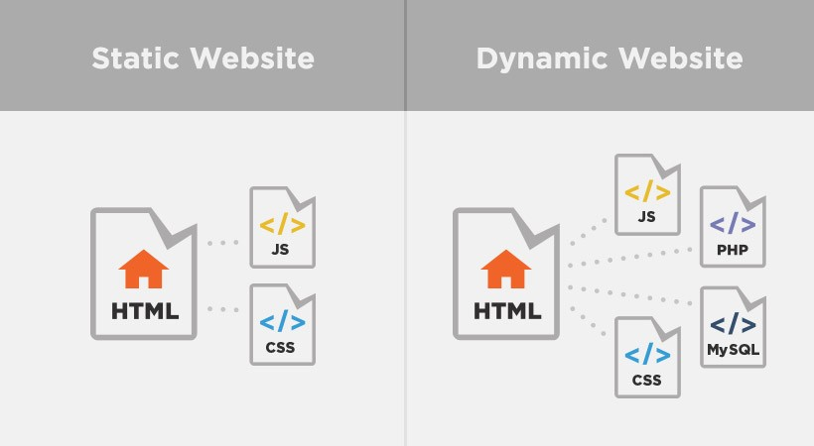
Hosts static websites
Static sites includes sites where nothing changes on the page unless the site developer changes it.
Example to the left:
HTML, CSS and JavaScript (JS) pages are known as static pages
Pages with PHP and MySQL, for example, are dynamic because content on the page can be changed by the user – think comments on blog posts, user log ins, etc.
Image source: https://www.pluralsight.com/blog/creative-professional/static-dynamic-websites-theres-difference

Slide 4
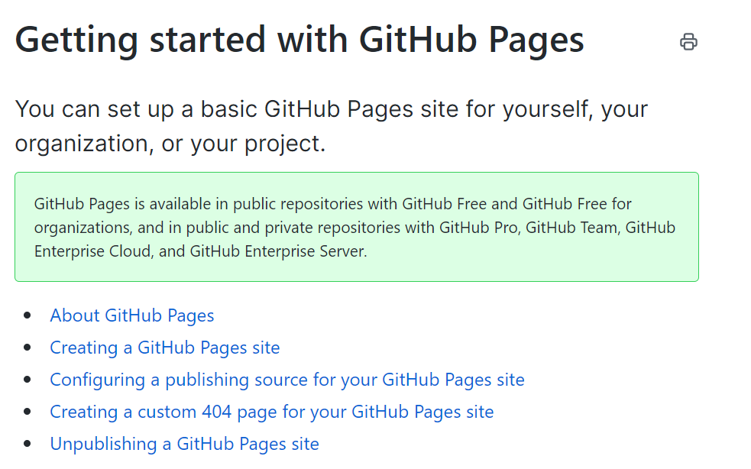
After today…
You will have continued access to files. If you run into an issue with accessing content, please contact me.
You can also setup your own GitHub account and GitHub Pages website. Follow instructions at the following link: https://docs.github.com/en/enterprise-server@3.1/pages/getting-started-with-github-pages

Slide 5
Github Pages Login (see packet)

